Slide 1
A comprehensive analysis of factorization of Semi prime number & possible way of complexity reduction
Team Member
Mohammod Al Amin Ashik 1326493
Md Shariful Islam 1412813
Ali Mohammad Tarif 418735

Slide 2
Little bit in number theory
Prime Number :
Only Devisable by Itself and 1 & greater than 1.
Ex: 2,3,5,7,11… ,2^{77,232,917} − 1,…
Composite Number :
Other than primer number.
Ex: 12 , 65
Semi Prime Number :
Product of 2 prime numbers
Ex: 5x7=35, 11*11=121

Slide 3
Importance of Prime Factorization in Cryptography
Importance Cryptography Algorithm’s security depend on Prime Factorization
Ex : RSA
n=p.q , ø(n)=(p-1)(q-1) , e.d=1 mod ø(n)
public encryption key: PU={e , n}, n is known publicly
If factorization was easy then we can find p, q, ø(n) & private key {d,n}.
n is a semi prime number
f(p,q)=n easy. f⁻¹(n)=?

Slide 4
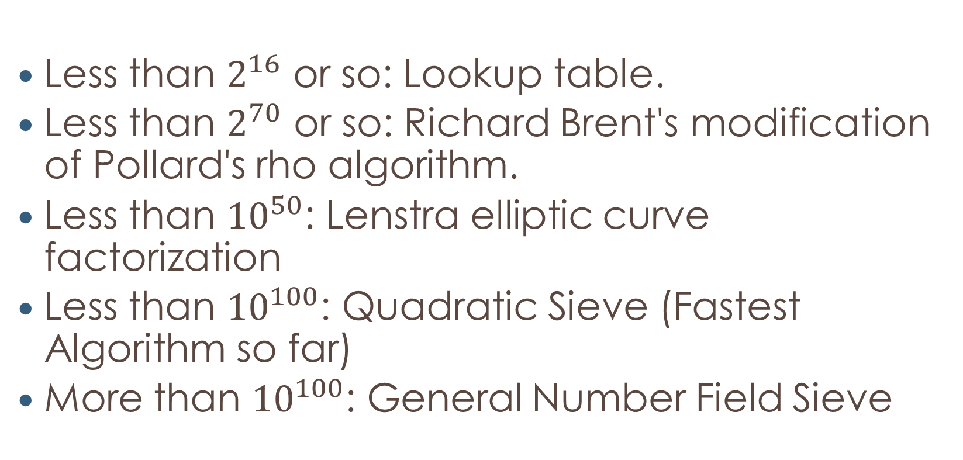
Existing Prime factorization Algorithm
Less than $2^{16}$ or so: Lookup table.
Less than $2^{70}$ or so: Richard Brent's modification of Pollard's rho algorithm.
Less than ${10}^{50}$: Lenstra elliptic curve factorization
Less than ${10}^{100}$: Quadratic Sieve (Fastest Algorithm so far)
More than ${10}^{100}$: General Number Field Sieve

Slide 5
What we noticed
Prime number: 2, 3, 5, 7, 11, 13, 17, 19, 23 …
5x5 + 5x0 = 25 = 5x5 7x7 + 7x0 = 49 = 7x7
5x5 + 5x2 = 35 = 5x7 7x7 + 7x4 = 77 = 7x11
5x5 + 5x6 = 55 = 5x11 7x7 + 7x6 = 91 = 7x13
5x5 + 5x8 = 64 = 5x13 7x7 + 7x10 = 49 = 7x17
17x17 + 17 x 0 = 289 19x19 + 19 x 0 = 361
17x17 + 17 x 2 = 323 19x19 + 19 x 4 = 437
17x17 + 17 x 6 = 391 19x19 + 19 x 6 = 475
Notice: 0,2,4,6,8,10 are devisable by 2.

Slide 6
Our Algorithm to generate all semi prime number n, where p is a factor of n.
=> d= next prime distance.
=> Initialize t=0, a= 6-d
=> While(true)
=> n=p.p+p.t
=> output n
=> t+=(6-d)
It will generate all semi prime number, but some of them are false semi prime.

Slide 7
Pattern we found
Every semi prime number n can be represented by
some of them by:
p.p+p.6.i=n
some of them by:
p.p+p.4.i=n
all of them by:
p.p+p.2.i=n
where i is any non negative number, p is a factor of n.

Slide 8
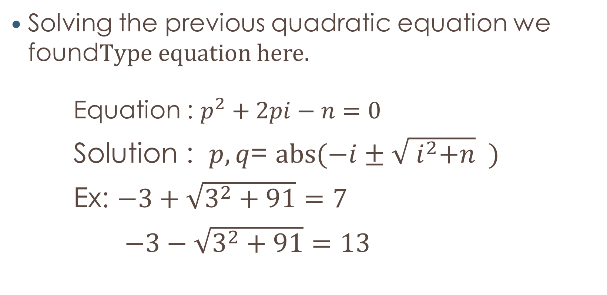
Pattern found
Solving the previous quadratic equation we found
Equation : $p^{2}+2pi−n=0$
Solution : $p,q$= $abs(−i±\sqrt{{ i}^{2}+n} )$
Ex: $−3+\sqrt{3^{2}+91}=7$
$−3−\sqrt{3^{2}+91}=13$

Slide 9
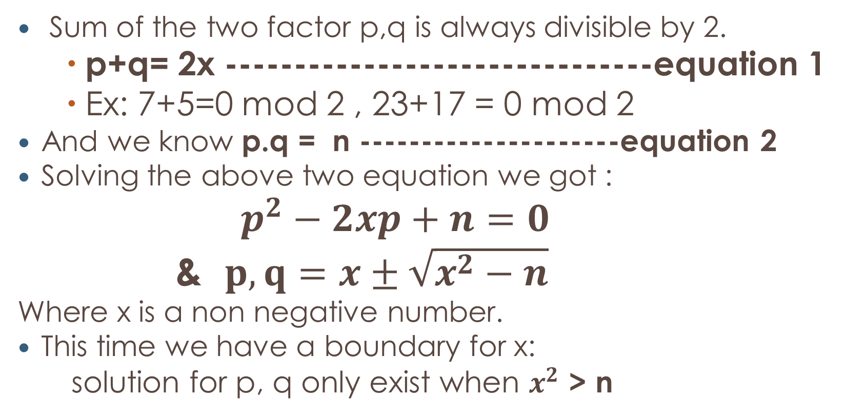
Equations of semi prime number
Sum of the two factor p,q is always divisible by 2.
p+q= 2x -------------------------------equation 1
Ex: 7+5=0 mod 2 , 23+17 = 0 mod 2
And we know p.q = n ---------------------equation 2
Solving the above two equation we got :
$$p^{2}−2xp+n=0$$
& $p,q=x±\sqrt{x^{2}−n}$
Where x is a non negative number.
This time we have a boundary for x:
solution for p, q only exist when $x^{2}$ > n

Slide 10

Equations of semi prime number
So far we have two equation:
$p^{2}−2xp+n=0$& $p,q=x±\sqrt{x^{2}−n}$
$p^{2}+2pi−n=0$ & $p,q$= $abs(−i±\sqrt{{ i}^{2}+n} )$

Slide 11
Evaluation
To get the factors of n , we have to plug different value of i and x.
We have bound for x but not for i.
Complexity: it’s a rather a brute-force method unless we find any pattern of i or x.

Slide 12
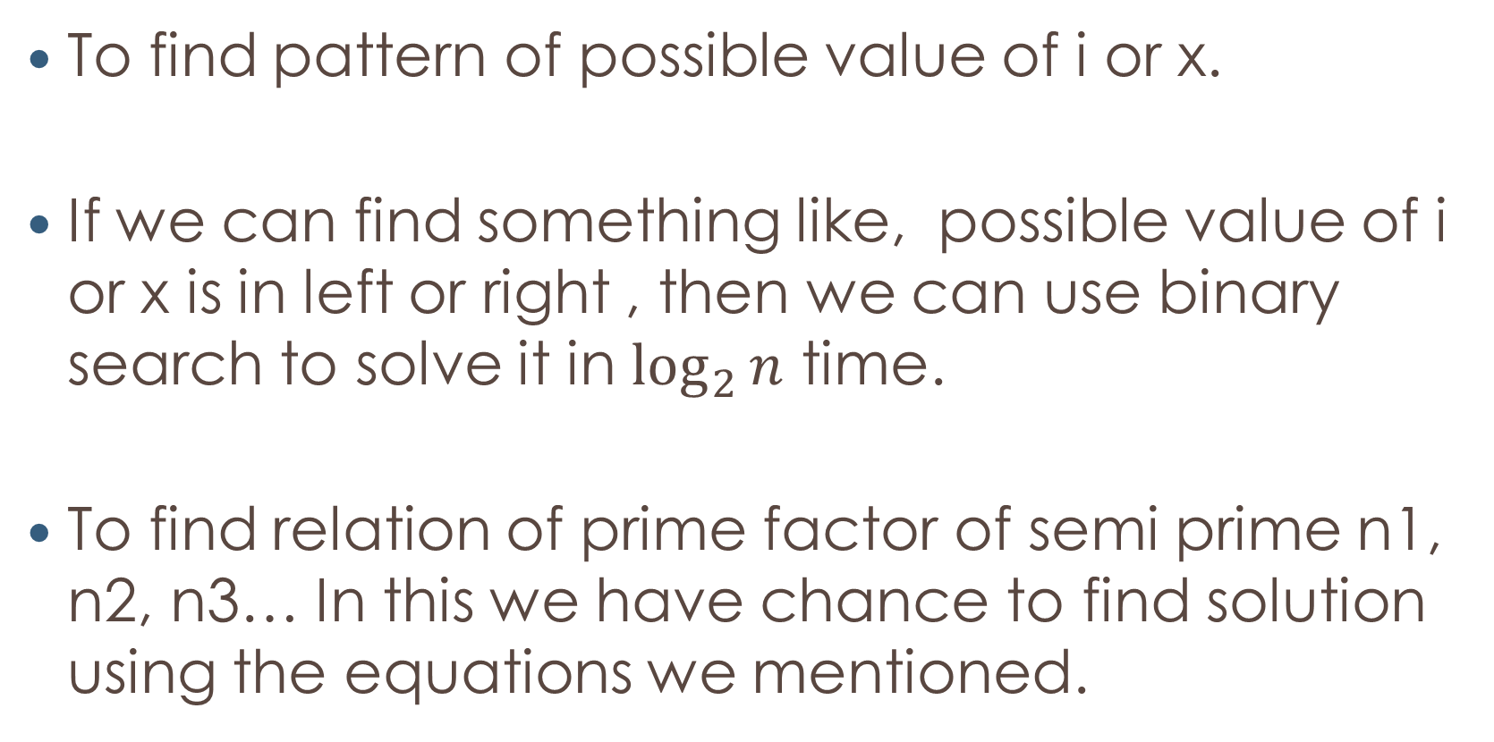
Future work & conclusion
To find pattern of possible value of i or x.
If we can find something like, possible value of i or x is in left or right , then we can use binary search to solve it in $\log_{2}{n}$ time.
To find relation of prime factor of semi prime n1, n2, n3… In this we have chance to find solution using the equations we mentioned.

Slide 13
Thank You

